Slide 1
Term Project CS689 Design & Implement Data Warehouse
Spring 2 2023
Rishika Kanodia

Slide 2
Airbnb & Crime
Aim
Design & implement a data warehouse to study the effects of internal and external factors like crime on Airbnb rental prices & occupancy rates
Dataset
Airbnb listings and calendar bookings for Seattle for Year 2016 - Kaggle
Seattle Police Department(SPD) record of Crimes committed in 2016 - data.seattle.gov website

Slide 3
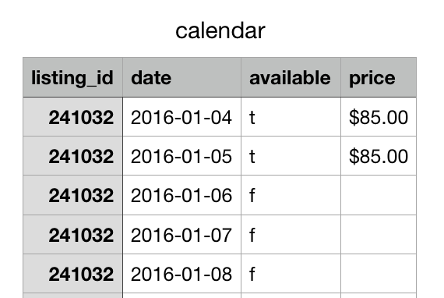
Airbnb Dataset
Contains booking data for each day in 2016 for each of the 3000+ Airbnb listings in Seattle
Challenges:
Price data missing for dates marked as “unavailable”

Slide 4
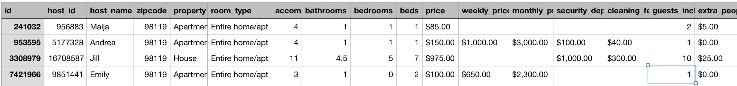
Airbnb Dataset
Listings.csv contains info about
-listing (property features, price, location, review scores)
-host (name, host_since , verified, superhost)
Listing.csv
Challenges:
Boolean column conversions
Clean $ from Price columns
Date column conversion: ‘Host Since’ to ‘Host in months
Fill attributes with missing values
Compare prices of different types of listings

Slide 5
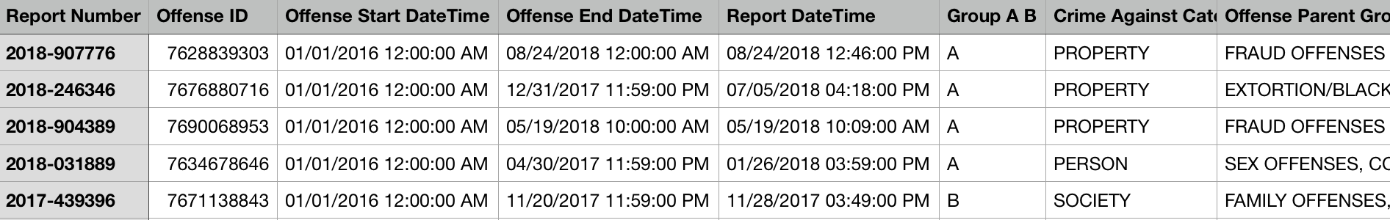
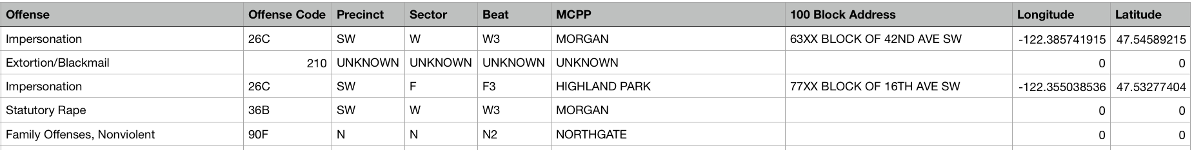
Seattle Police Department Crime Dataset
Challenges:
Converting Longitude & Latitude → Neighborhood & District attributes to join crime dataset with Airbnb listings dataset

Slide 6
Business Questions
How does availability and rental prices of listings change over time?
For different property types, what is the average price per guest in every quarter of 2016?
How did a hosts ‘super host’ tag affect their listings occupancy rate, prices and review scores in 2016?
How does crime rate vary by district and neighborhoods?
How does crime rate influence the average annual revenue earned by listings in a neighborhood?

Slide 7
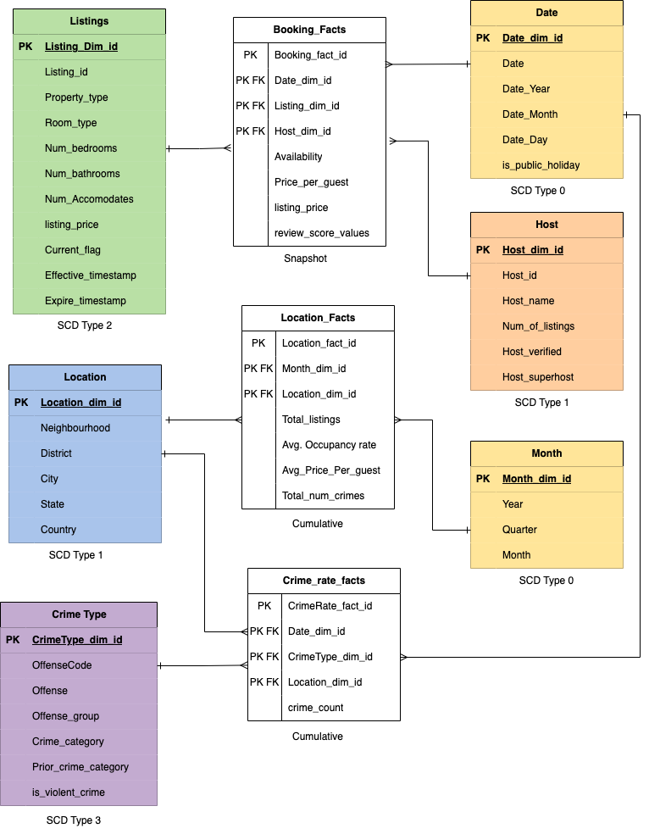
Constellation Schema

Slide 8
Data Flow Diagram
Python
MS SQL
Date
Listing
Month
Host
Booking
Fact
Airbnb
Listings
MERGE
Listings
&
Calendar
Date
Booking Staging
Listing
Airbnb
Calendar
T
T
Host
Month
Location
Location
LOAD
Booking Staging
Booking
Staging
Location
Fact
Crime Fact Staging
SPD crime
Add
Location
to
Crime
Date
T
T
Crime Type
Location
Crime Rate Fact
Crime Fact Staging
Crime Type
Crime Fact Staging

Slide 9
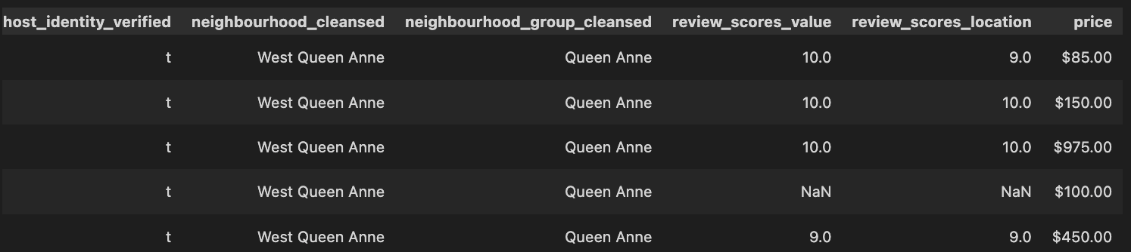
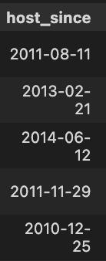
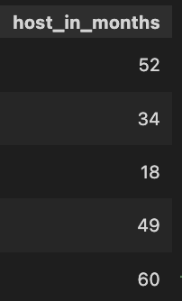
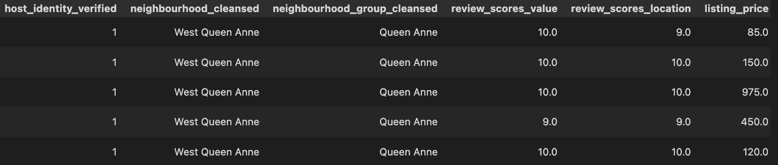
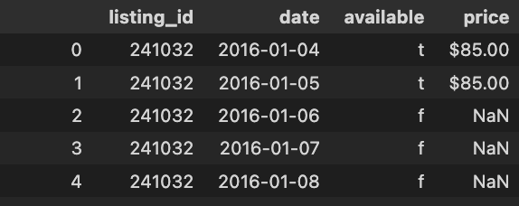
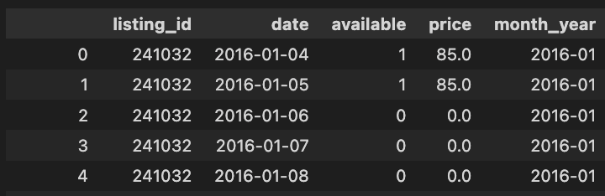
Transform
Airbnb Listing Data frame: Boolean to INT, remove ‘$’
DATE to INT
Airbnb Calendar Data frame: Fill missing values, Boolean to INT, remove ‘$’

Slide 10
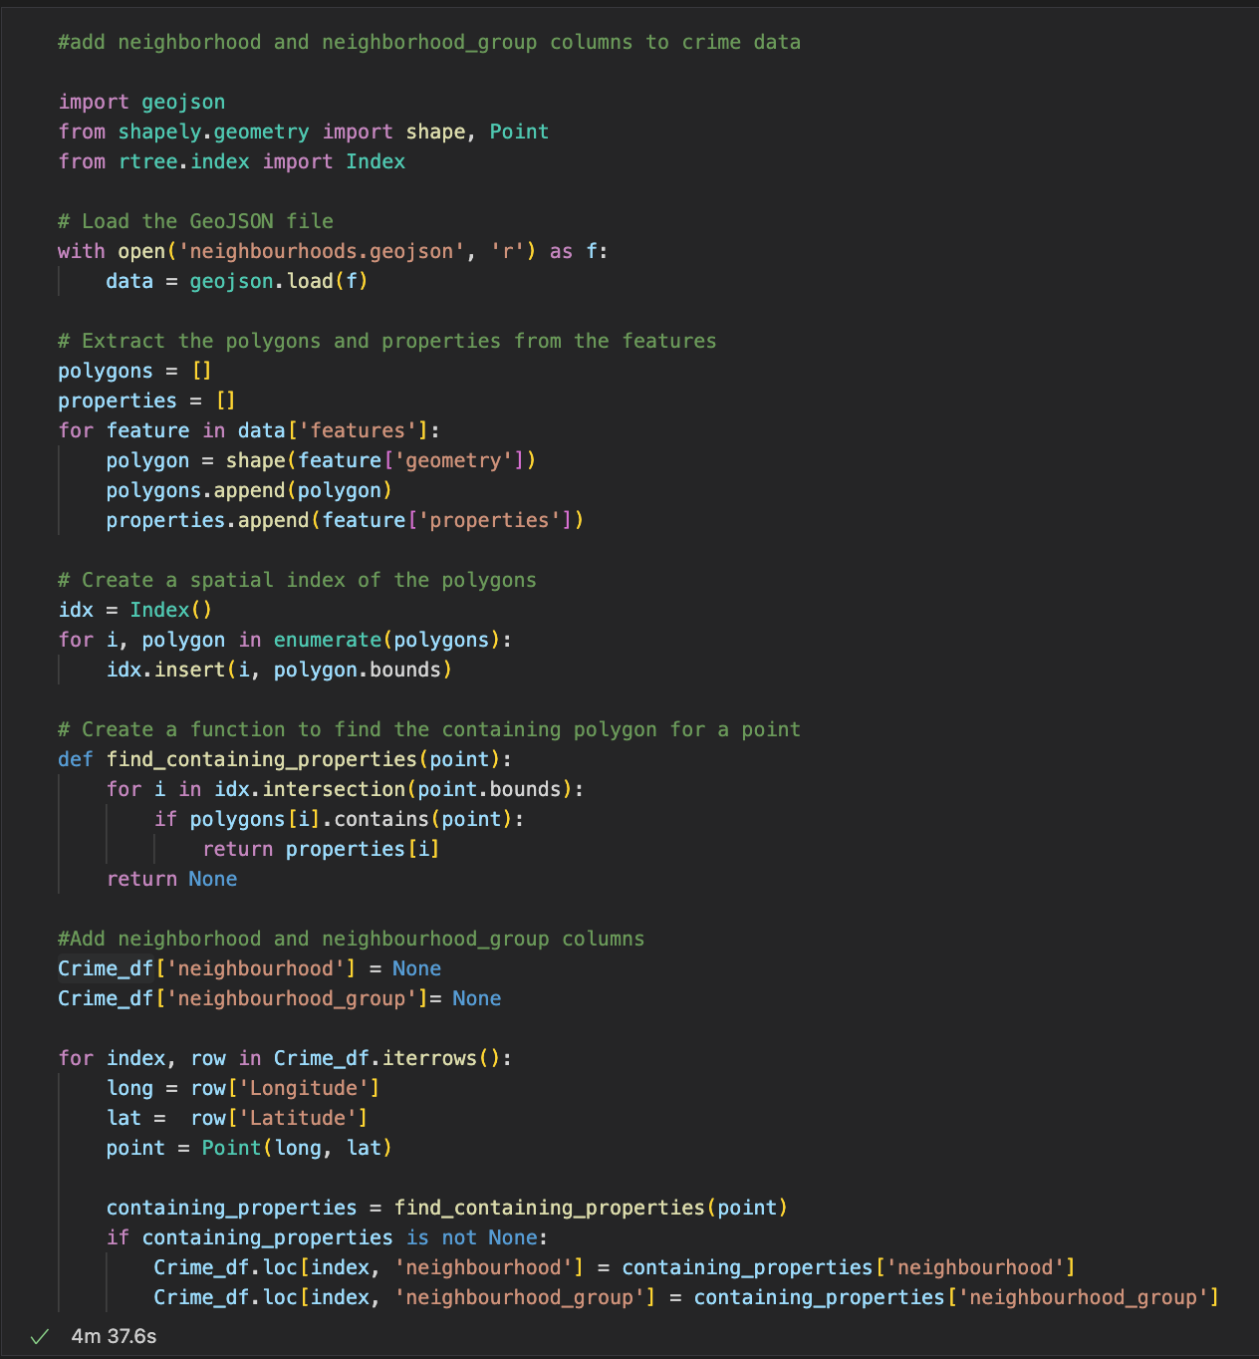
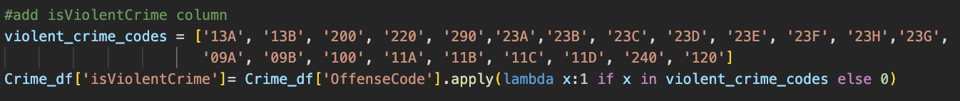
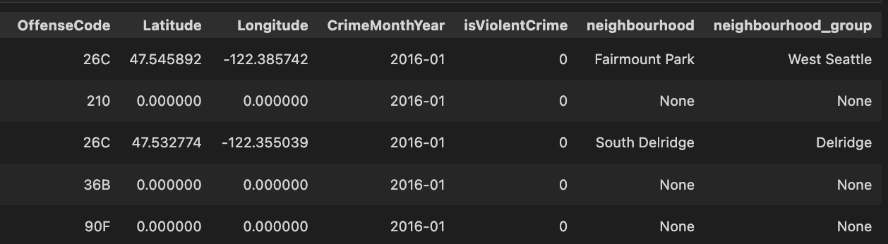
Transform
Code to get neighborhood from latitude & longitude
Add is_violent _crime column: If offense code is violent crime
Crime Dataframe with neighbourhood & district columns

Slide 11
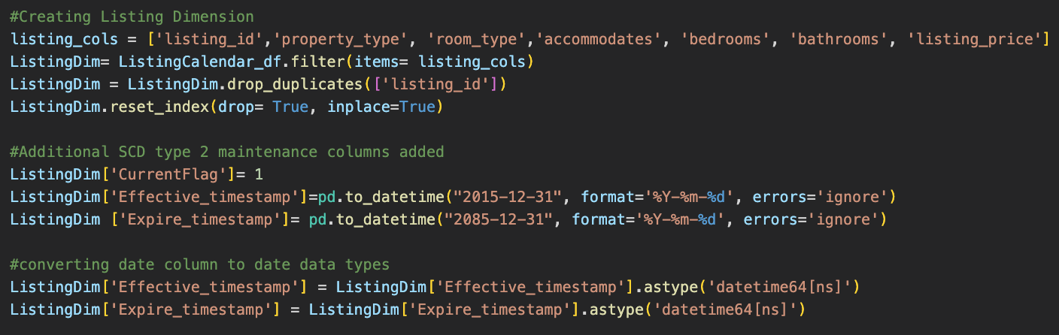
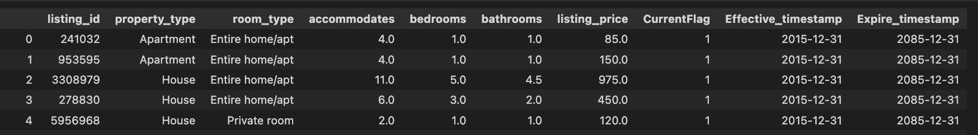
Transform: Create Dimension tables
SCD 2: Listing Dimension

Slide 12
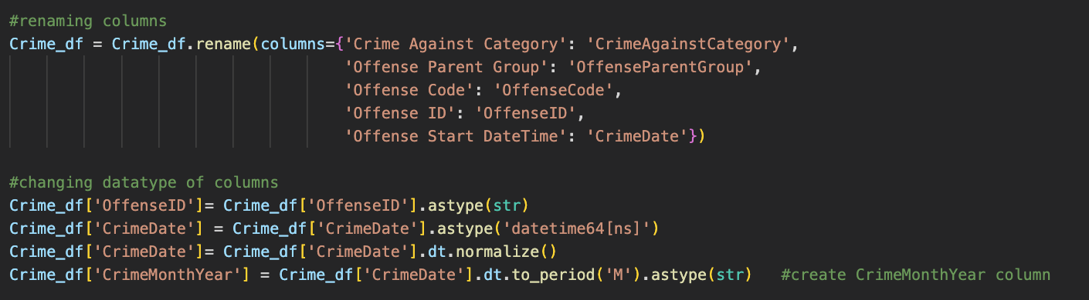
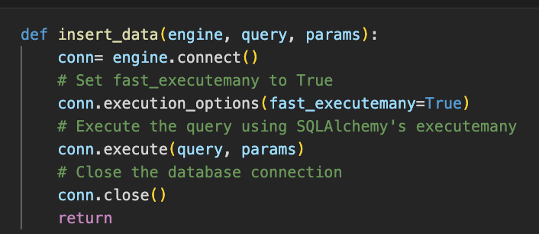
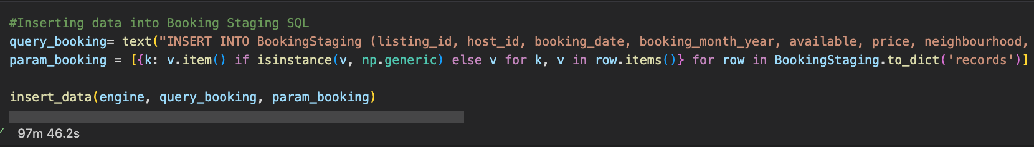
Load
Challenges: Errors due to Data Types , Space in Column Names
Code to Bulk load data
Challenges: Load time

Slide 13
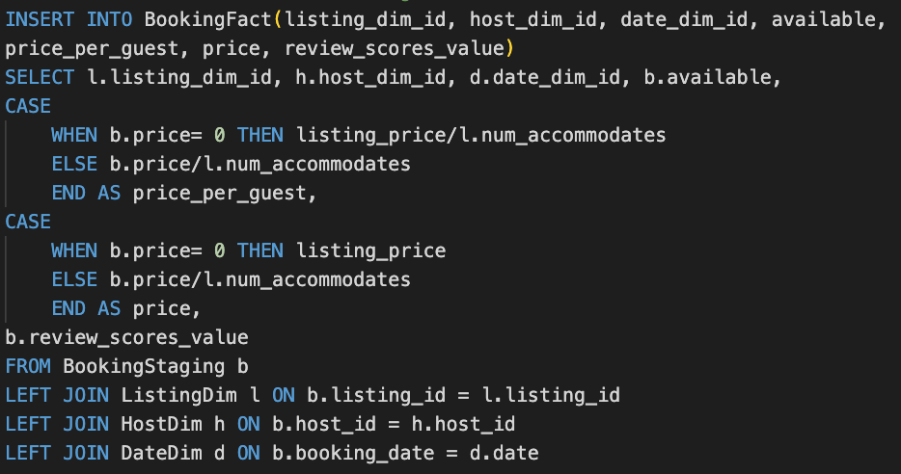
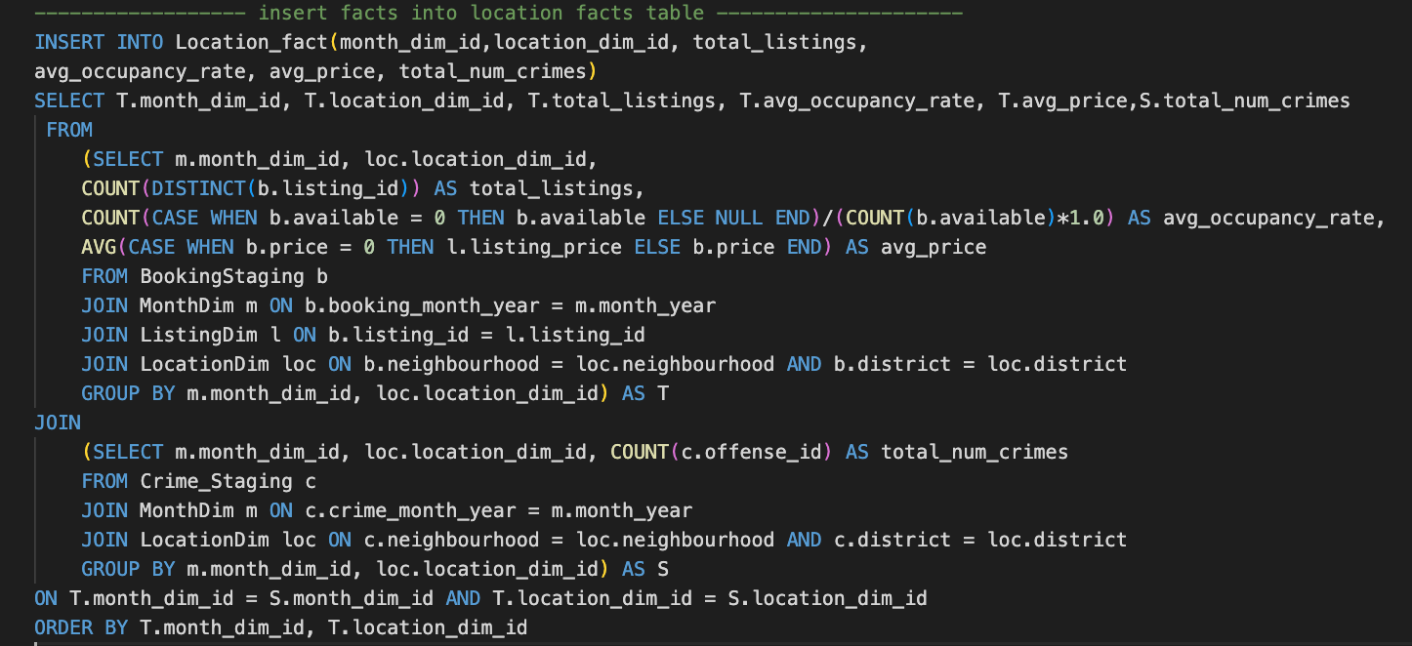
Fact Table Load in SQL
Booking Fact table
Dimension ID as foreign keys to Fact tables
Calculated field- Price per guest
Location Fact table
In line views to join Airbnb booking facts & crime facts on location attribute values

Slide 14
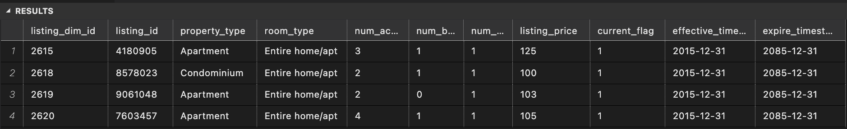
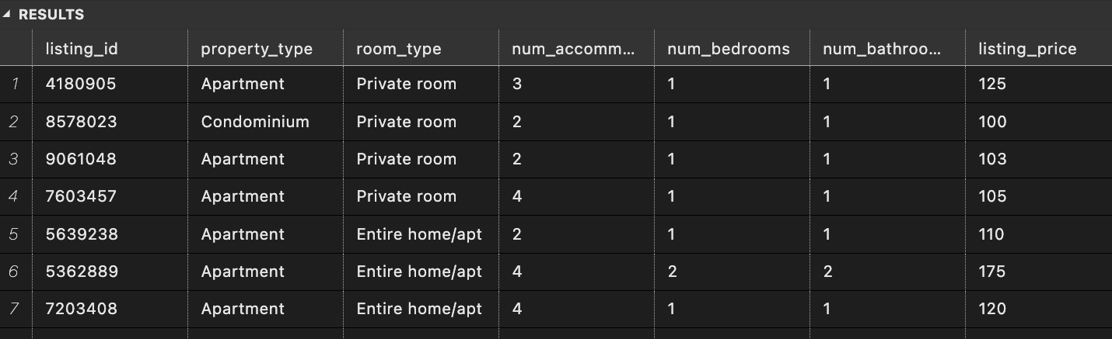
Delta Load: SCD Type 2 Dimension
Original Records in Listing Dimension SQL
Delta records: Room Type changed from ‘Entire home/apt’ to ‘Private Room’

Slide 15
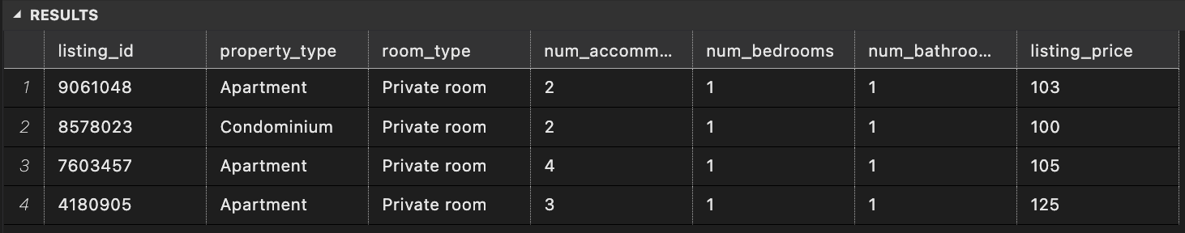
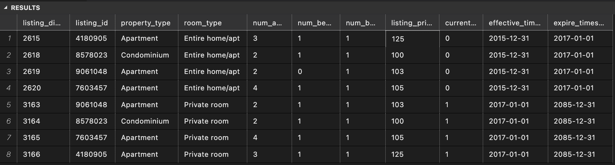
Delta Load: SCD Type 2
Code to identify updated records
SELECT * FROM DeltaListingDim
EXCEPT
SELECT listing_id, property_type, room_type, num_accommodates,num_bedrooms, num_bathrooms, listing_price
FROM ListingDim
Code to update old records & insert new records
UPDATE ListingDim
SET expire_timestamp = '2017-01-01', current_flag = 0
WHERE listing_id IN
(SELECT Delta.listing_id
FROM (SELECT * FROM DeltaListingDim
EXCEPT
SELECT listing_id, property_type, room_type, num_accommodates,num_bedrooms, num_bathrooms, listing_price
FROM ListingDim) Delta)
INSERT INTO ListingDim(listing_id, property_type, room_type, num_accommodates, num_bedrooms, num_bathrooms, listing_price, current_flag, effective_timestamp, expire_timestamp)
SELECT *, 1 AS current_flag, '2017-01-01', '2085-12-31'
FROM (SELECT * FROM DeltaListingDim
EXCEPT
SELECT listing_id, property_type, room_type, num_accommodates,num_bedrooms, num_bathrooms, listing_price
FROM ListingDim) Delta
Updated old records & changed records inserted
Current Flag set to 0
Updated Expired timestamp

Slide 16
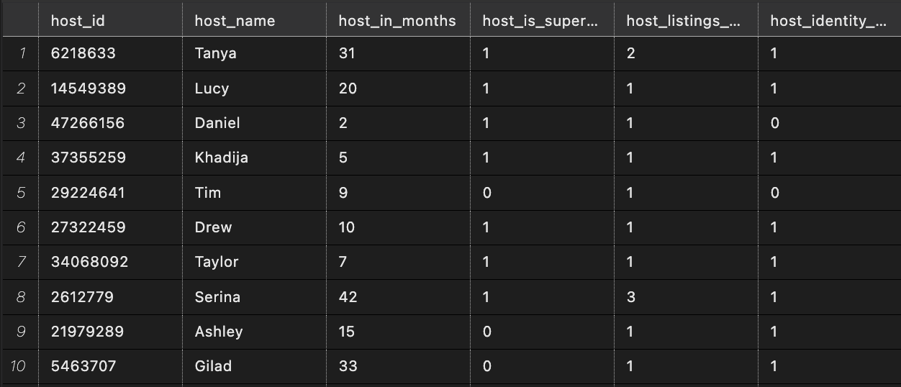
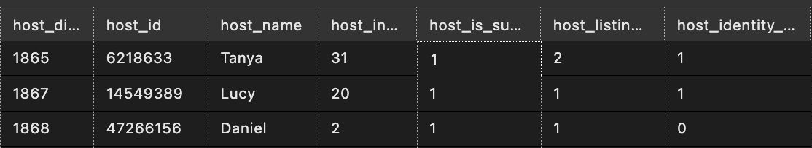
Delta Load: SCD Type 1
Delta records: ”Host is superhost” changed from 0 to 1
Code to update old records
MERGE HostDim AS Target
USING DeltaHostDim AS Source
ON Source.host_id = Target.host_id
-- For Inserts
WHEN NOT MATCHED BY Target THEN
INSERT (host_name, host_in_months, host_is_superhost,
host_listings_count, host_identity_verified)
VALUES (Source.host_name, Source.host_in_months,
Source.host_is_superhost, Source.host_listings_count,
Source.host_identity_verified)
-- For Updates
WHEN MATCHED THEN UPDATE SET
Target.host_name = Source.host_name,
Target.host_in_months = Source.host_in_months,
Target.host_is_superhost = Source.host_is_superhost,
Target.host_listings_count = Source.host_listings_count,
Target.host_identity_verified = Source.host_identity_verified;
Host Dimension: Updated records

Slide 17
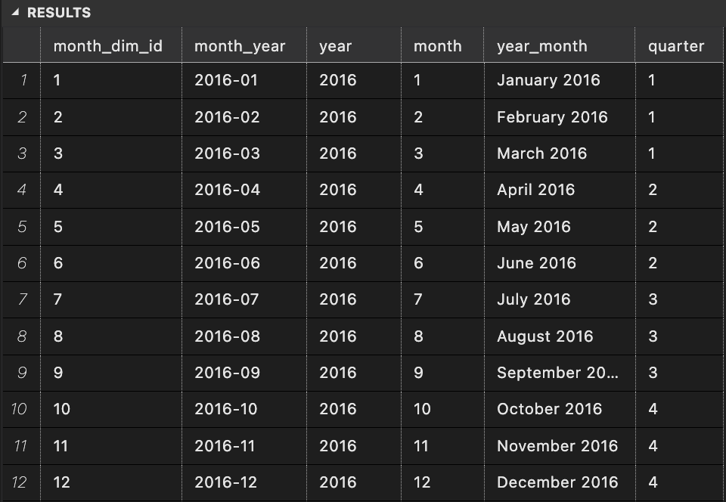
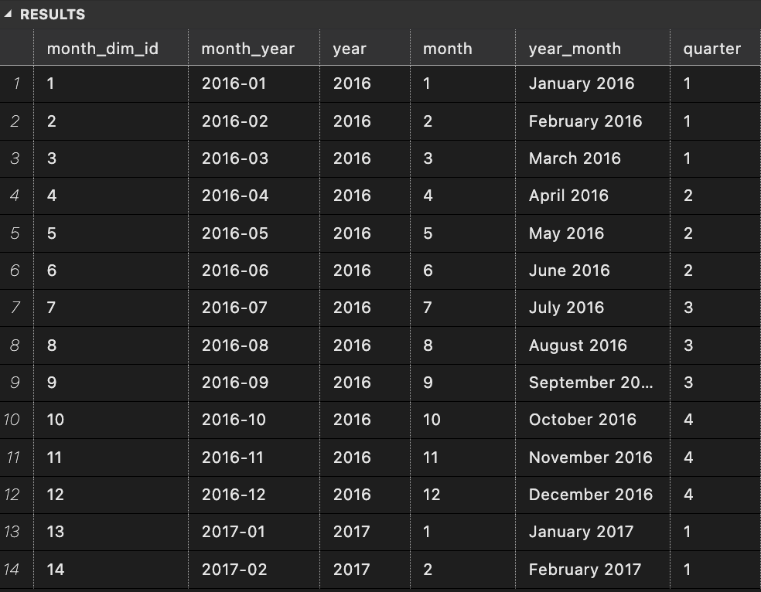
Delta Load: SCD Type 0
Month Dimension: Original records
Updated Month Dimension SQL
Jan 2017 & Feb 2017 records inserted
MERGE MonthDim AS Target
USING DeltaMonthDim AS Source
ON Source.month_year = Target.month_year
WHEN NOT MATCHED BY Target THEN
INSERT (month_year, year, month, year_month, quarter)
VALUES (Source.month_year, Source.year, Source.month, Source.year_month,
Source.quarter);

Slide 18
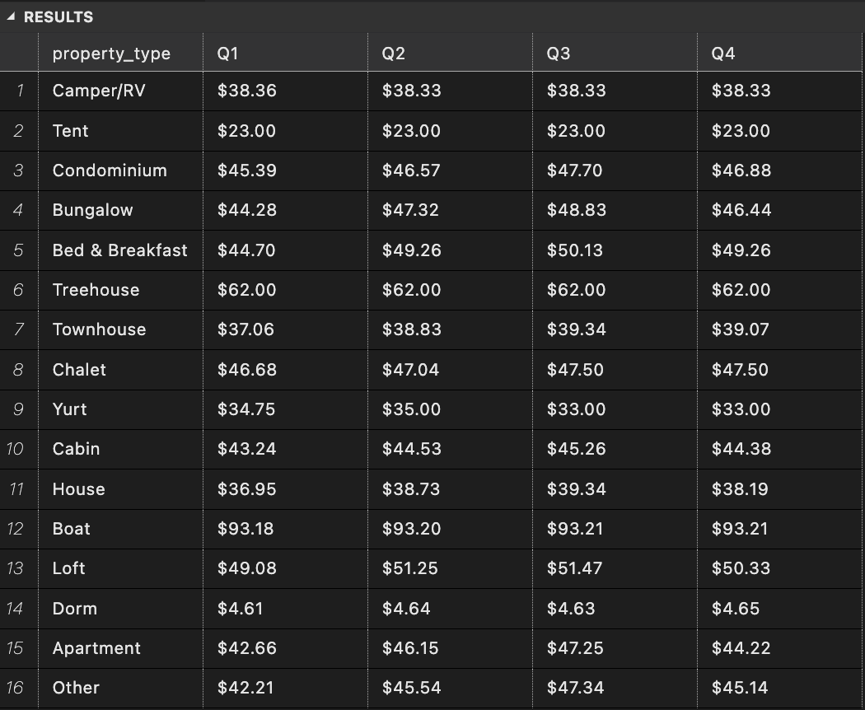
SQL Queries
For different property types, what is the average price per guest in every quarter of 2016?
SELECT property_type,
format([1], ‘$0.00') as [Q1],
format([2], ‘$0.00') as [Q2],
format([3], ‘$0.00') as [Q3],
format([4], ‘$0.00') as [Q4]
FROM(
SELECT l.property_type, d.quarter, price_per_guest
FROM BookingFact b
JOIN DateDim d ON b.date_dim_id = d.date_dim_id
JOIN (
SELECT listing_dim_id, property_type
FROM ListingDim
WHERE current_flag = 1) l
ON b.listing_dim_id = l.listing_dim_id
WHERE d.year = 2016) listing_detail
PIVOT(
AVG(price_per_guest)
FOR quarter IN ([1],[2],[3],[4])) AS pvt

Slide 19
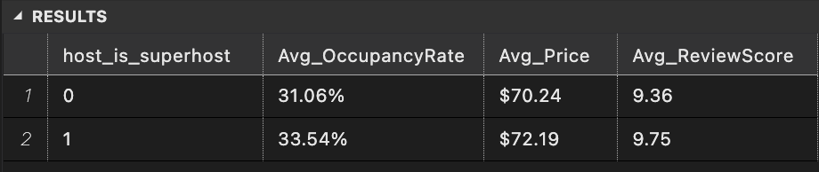
SQL Queries
How did a hosts ‘super host’ tag affect their listings occupancy rate, prices and review scores in 2016?
SELECT
h.host_is_superhost,
FORMAT(COUNT(CASE WHEN b.available = 0 THEN 1 ELSE NULL END)/(COUNT(b.available)*1.0), 'P2') AS Avg_OccupancyRate,
FORMAT(AVG(price), 'C2') AS Avg_Price,
FORMAT(AVG(review_scores_value), '0.00')AS Avg_ReviewScore
FROM BookingFact b
JOIN HostDim h ON b.host_dim_id = h.host_dim_id
JOIN (
SELECT listing_dim_id
FROM ListingDim
WHERE current_flag = 1) l
ON b.listing_dim_id = l.listing_dim_id
GROUP BY h.host_is_superhost
ORDER BY h.host_is_superhost

Slide 20
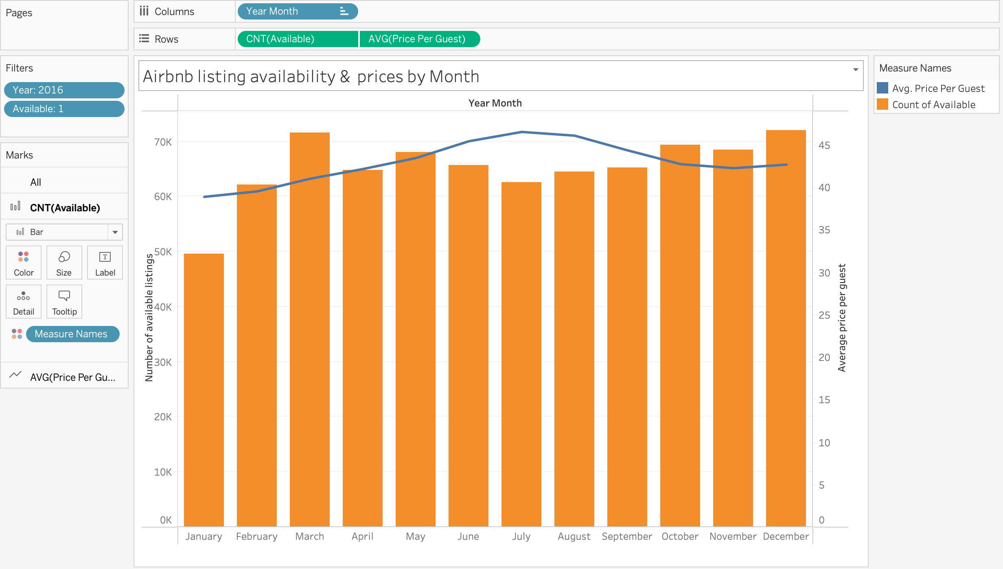
Visualization: Filter
How does availability and prices of Airbnb listings vary by month ?

Slide 21
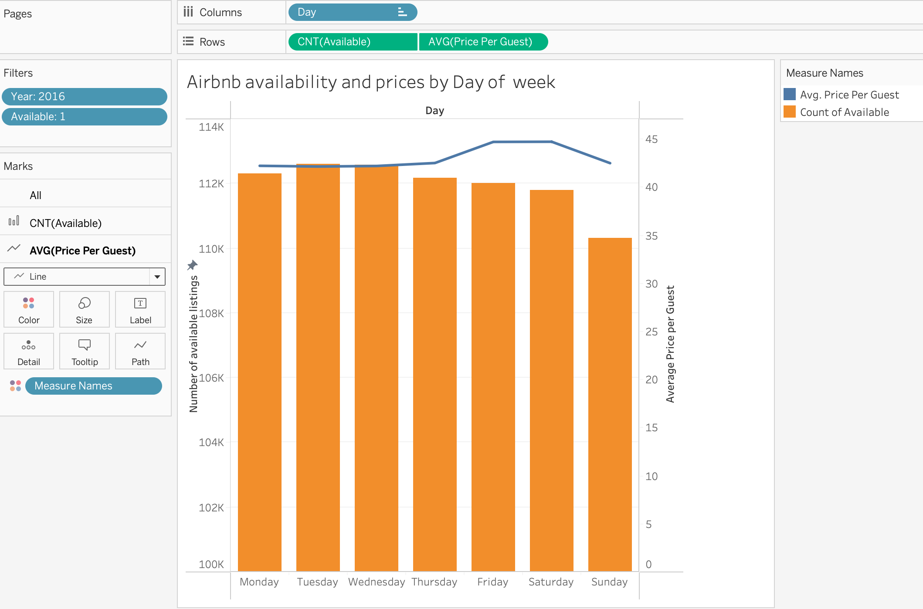
Visualization: Filter
How does availability and prices of Airbnb listings vary by day of week ?

Slide 22
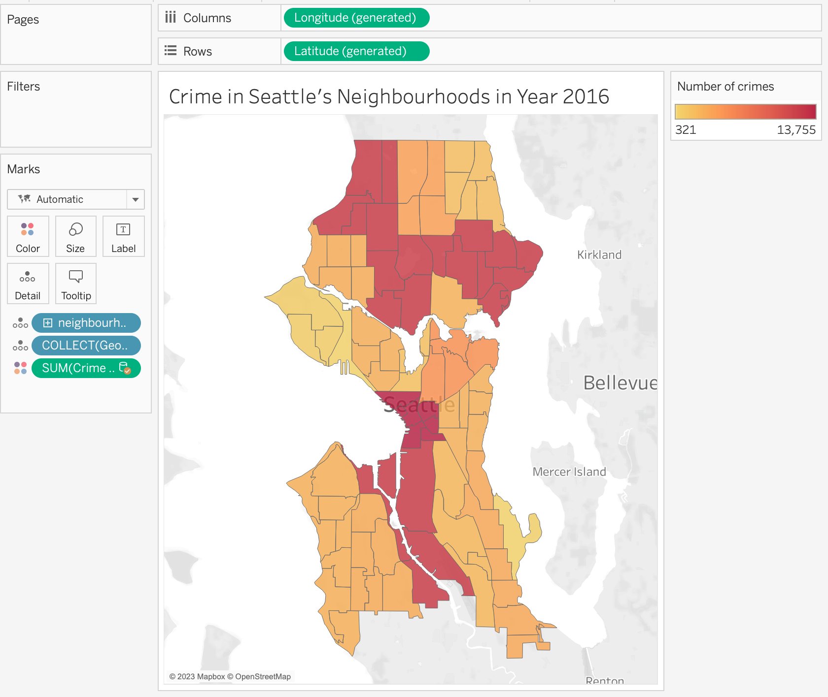
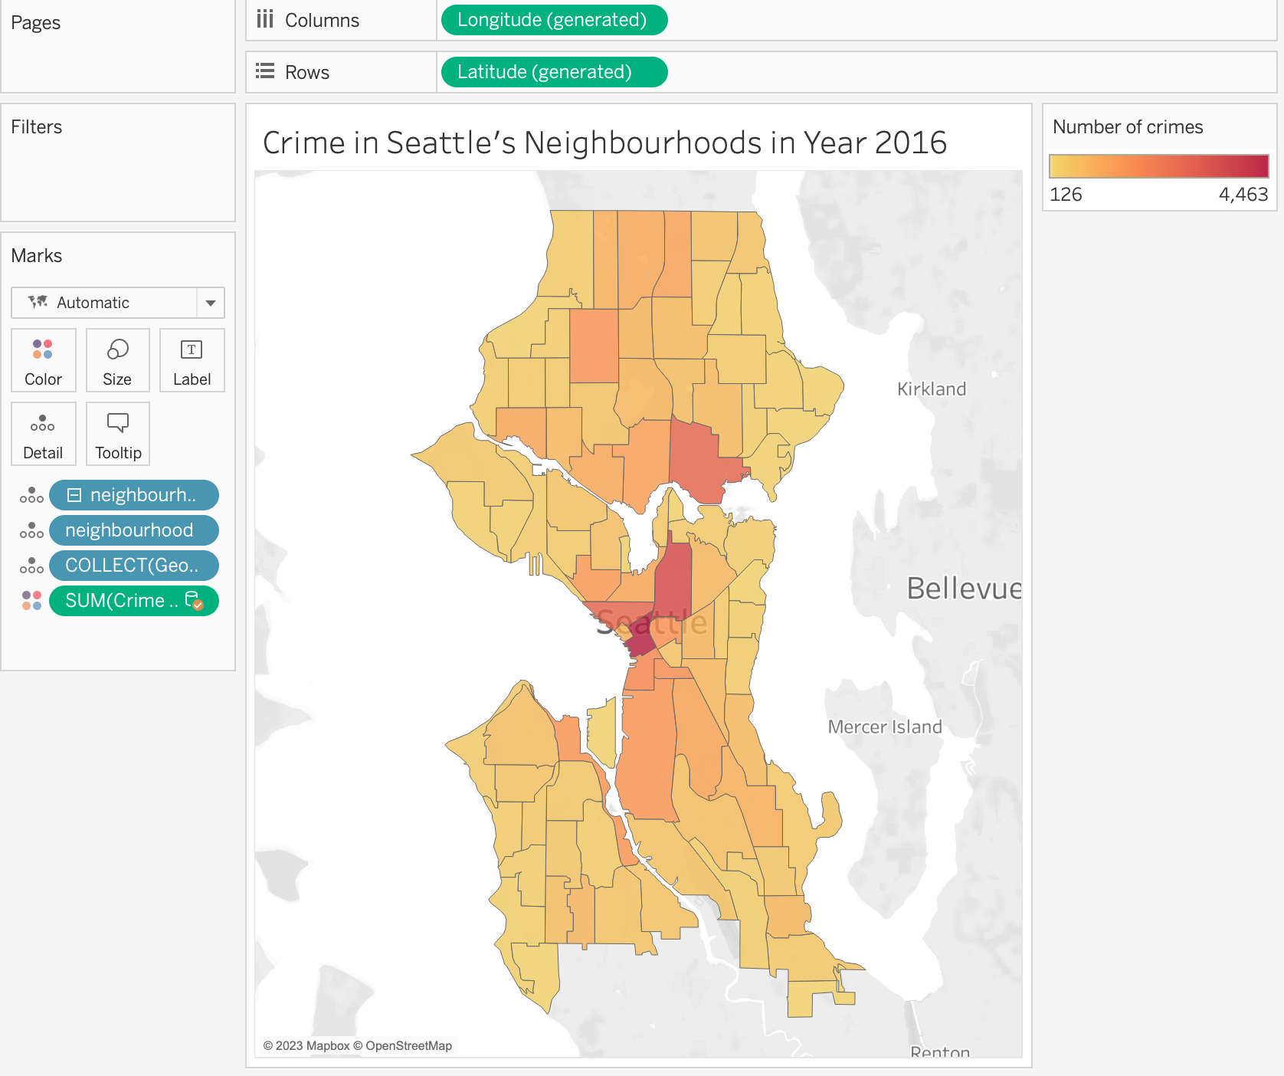
Visualization: Location Hierarchy
Total Number of crimes by District
Drill down
Total Number of crimes by Neighborhood

Slide 23
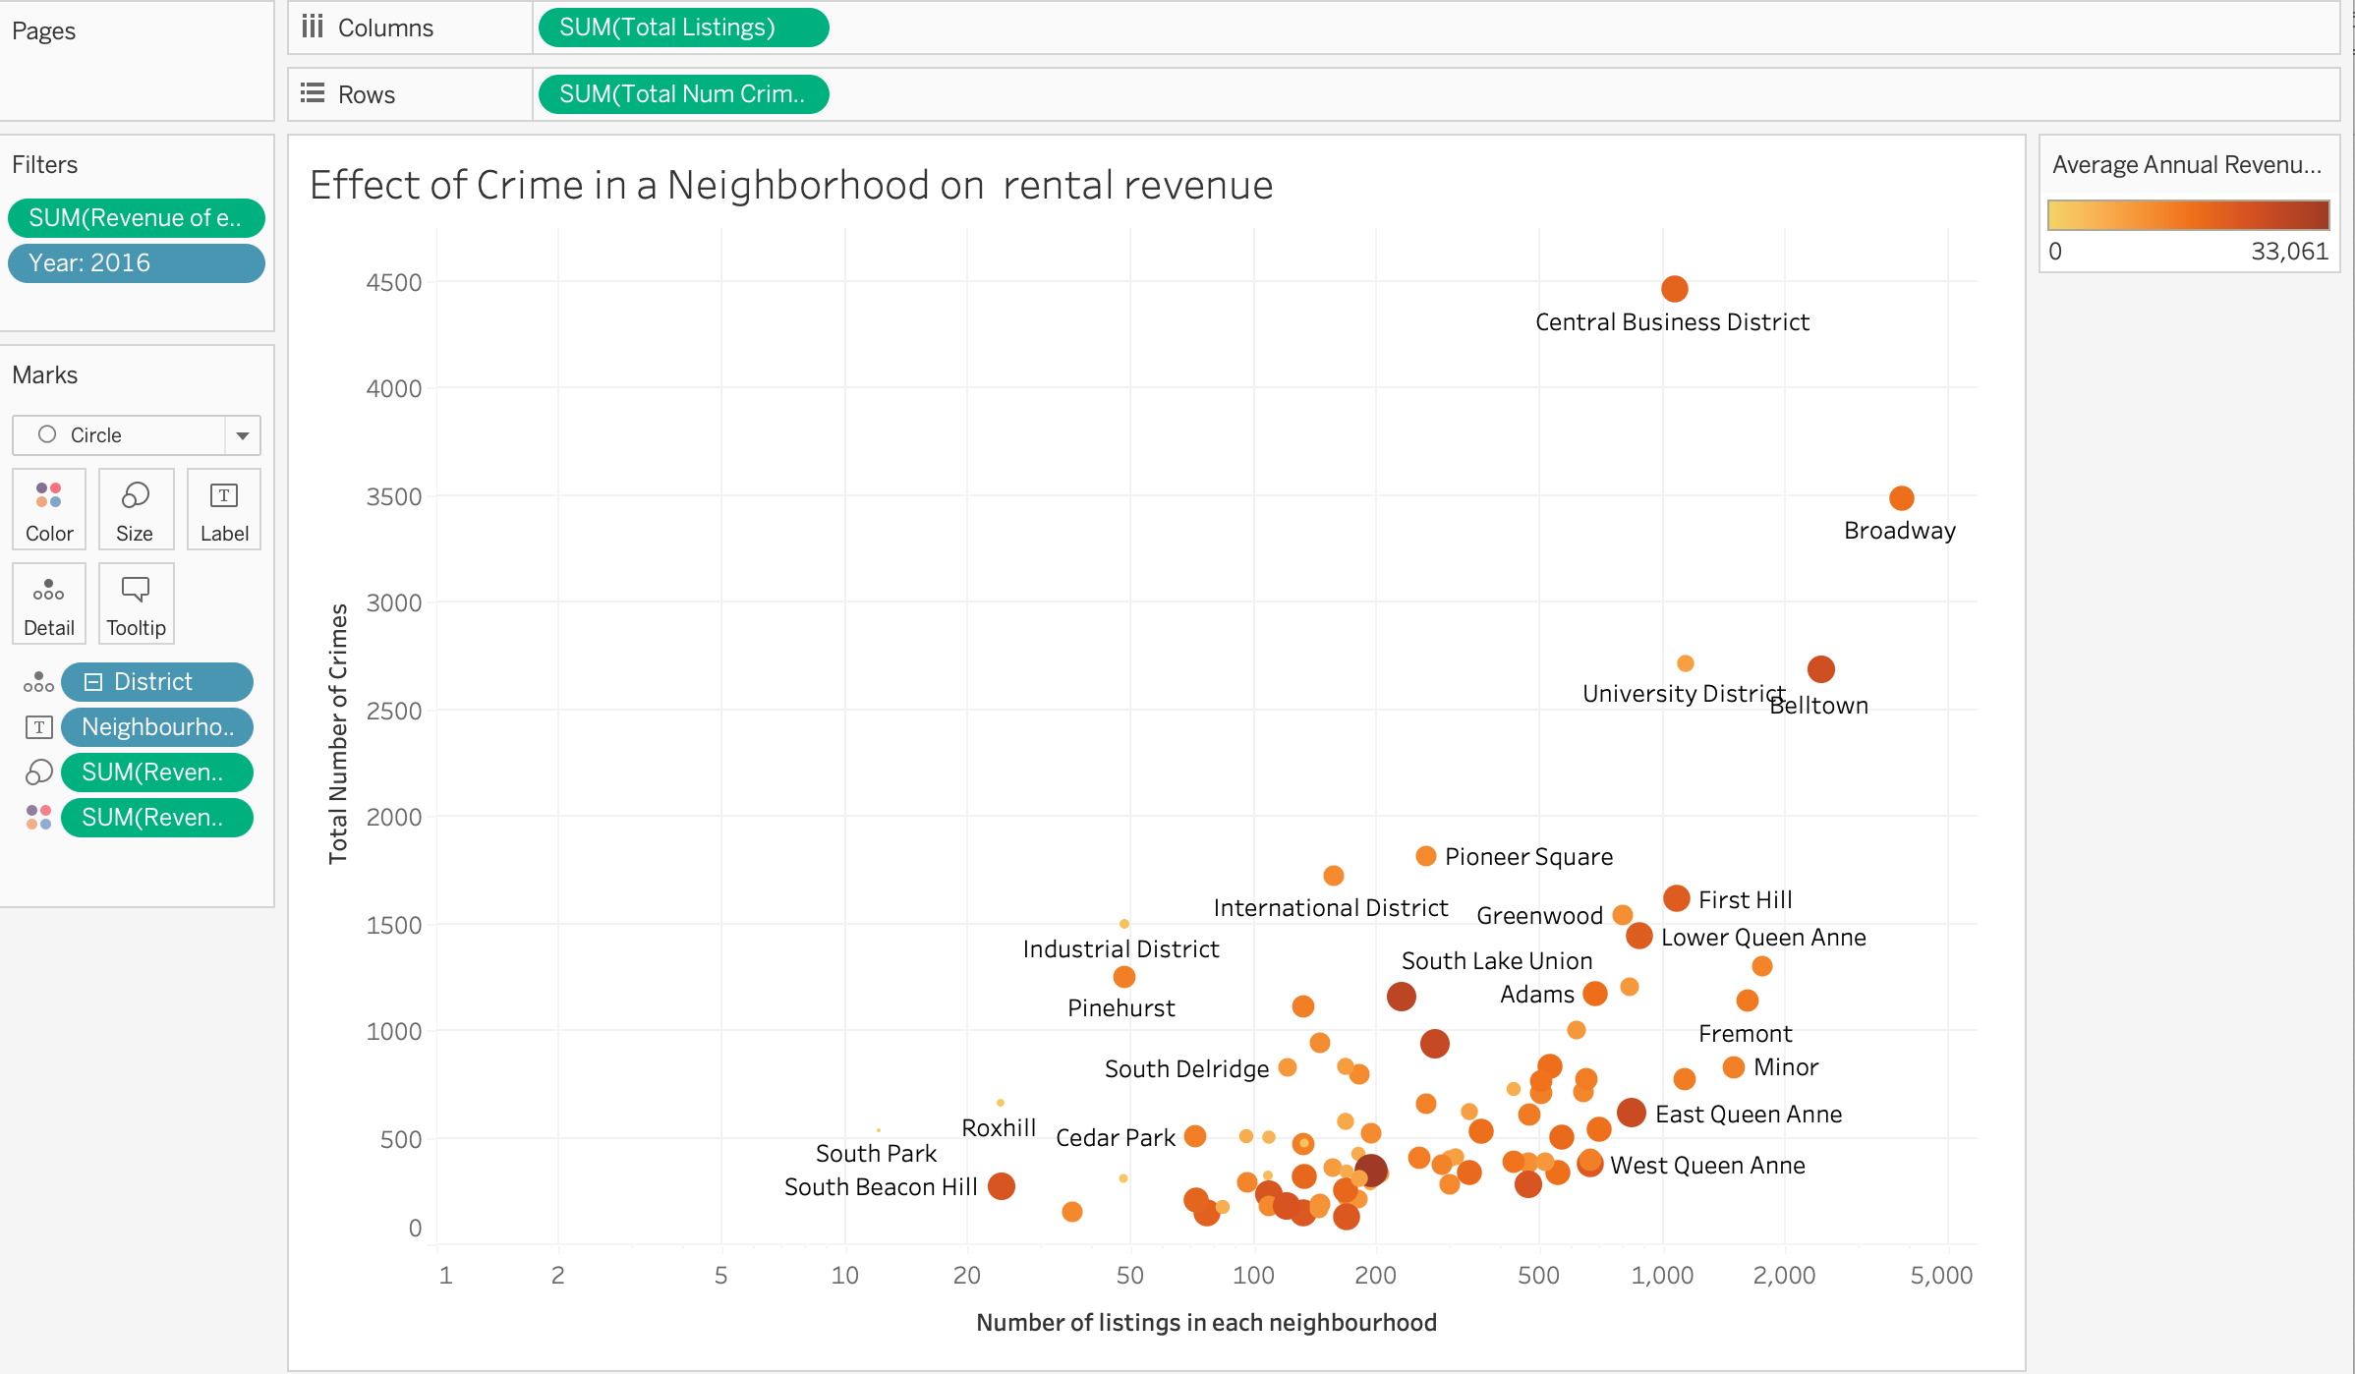
Visualization: Calculated Field
How does crime affect the average annual revenue earned by listings in a neighborhood ?

